Slide 1
Week 2
Relationships in the data: Correlations and scatterplots

Slide 2
Session overview
Topics
Examples
Correlations
Scatterplots
Predictions and “variance explained”
MPG and horsepower
MPG and horsepower, US Dept. of Health’s Covid-19 data.
US Dept. of Health’s Covid-19 data.

Slide 3
Glossary
Variable: Any characteristics of an individual. A variable can take different values for different individuals . Categorical or quantitative (e.g., gender and age). Independent variable -> dependent variable (e.g., high cholesterol -> heart disease, number of past visits -> LOS).
Significance: After selecting an alpha level (e.g., A= 0.05), we check if correlations are sufficiently away from 0 to indicate they are unlikely to happen by chance. For example, when R= -0.78 with p <0.01, it indicates there is less than a 1% chance of being wrong in rejecting the null hypothesis that there is no correlation. We feel confident in saying there is a significant correlation. We then consider if it is a substantial correlation.
Outlier: (1.5 * IQR) above the 75th and below the 25th percentile. For example, outliers in MPG are found below -4.3 (doesn’t exist) or above 33.1. We have 1 outlier car with an MPG= 33.9.
Causation vs. correlation vs. confounding: Causation indicates a cause-and-effect path. Cause and effects can be correlated but correlations are not necessarily cause-and-effects. Confounders can be a 3rd variable correlated with both causes and effects that impact the relationship (e.g., motivation can confound the correlation between math ability and SAT math scores).
Composite variable: A constructed variable that is the mean of 2 highly correlated variables (e.g., R >= 0.95 or 0.90). Generally on the same scale (e.g., air flow tests of different devices, HCAHPS).
Reliability: Often referred to as the correlation between two variables (e.g., air flow tests of different devices). If the alternative but less expensive device is highly correlated with the gold standard device, we purchase the lower costing device.

Slide 4
Correlations
Spearman correlations are basically the relationship in rank order of 2 variables. Other correlations use different formulas but the general concept of showing relationships or associations between variables remains constant.
The correlation coefficient (R) ranges from -1 to 1. Negative and positive correlations. R=0 indicates no correlation.
The following rules apply to positive correlation values but have similar meaning for negative correlations. General guidelines in the strength of correlations: 1) >= 0.70 is strong, 2) 0.30 – 0.70 is moderate, 3) < 0.30 is weak, 4) 0.0 = no correlation, 5) correlations of -1 or 1 are perfect correlations.

Slide 5
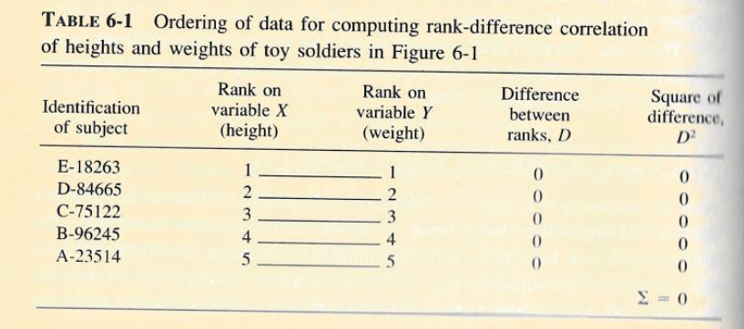
Positive correlation calculation
Notice the rank on X matches the rank in Y. As one values goes up, the other values goes up. This is a perfect positive correlation (R= 1.0).

Slide 6
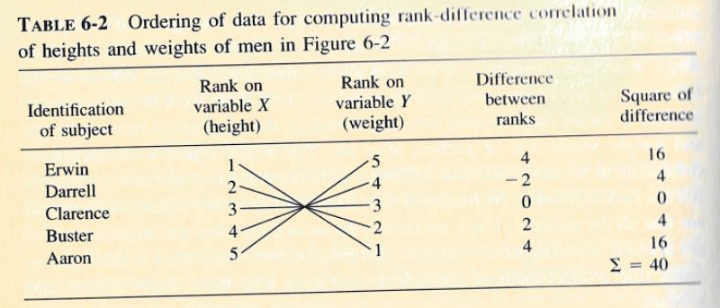
Negative correlation calculation
For perfect negative correlations, the rank on X matches is in the opposite rank in Y. As one values goes up, the other values goes down (R= -1.0).

Slide 7
Special considerations
Small sample statistic. Correlations are helpful with large and small samples.
Aggregated data. Aggregated data can be helpful when there is at least 25-30 rows of data. Consider a correlation test for 2 to 3 years of monthly data. However, it is important to caution this use because aggregated data can mask variance and inflate correlation coefficients (i.e., correlations could look better than they are).
R^2 represents the amount of variance in Y (dependent variable) explained by X (independent variable). Knowing X gives us an idea of why we get different Y values. For example when R= -0.78, the R^2 is 0.60. The Pearson correlation gives the same R^2 that we get from a single linear regression.
Pearson, Spearman, and Kendall tau correlations can handle continuous, ordinal, and binary data. Kendall works especially well in ordinal correlations, Spearman work well in skewed data. Pearson fastest to calculate results.
Partial correlations control for other variables but we get more power in regression.

Slide 8
Examples
Scatterplots with correlation tests, correlation matrix and setting up studies.

Slide 9
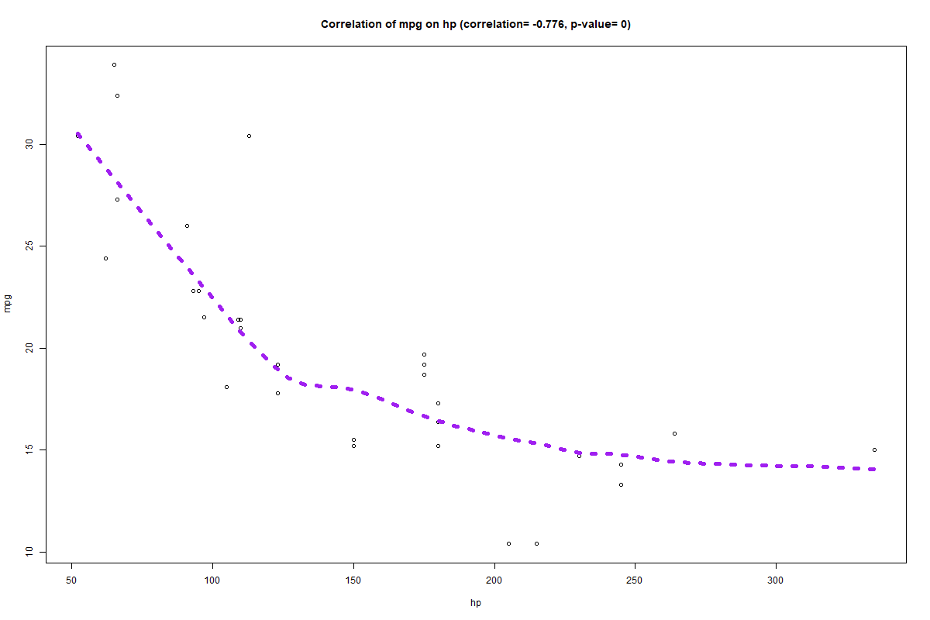
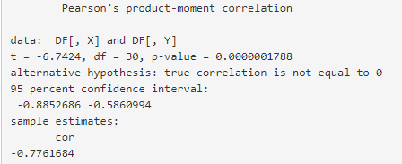
Negative and strong correlation
1. The Pearson correlation is R= -0.78 and significant (p <0.001). We would consider it a strong correlation. We are safe saying that higher HP can lower MPG.
2. From the correlation test output, we calculate the R^2 of 0.60 which indicates that knowing a cars horsepower gives us a good idea of what the expected MPG is. In other words, HP explains 60% of the MPG variance.
N = 32
Use the line to make a prediction
The y-axis is used for our outcomes when applicable. The X-axis is often for predictor variables.

Slide 10
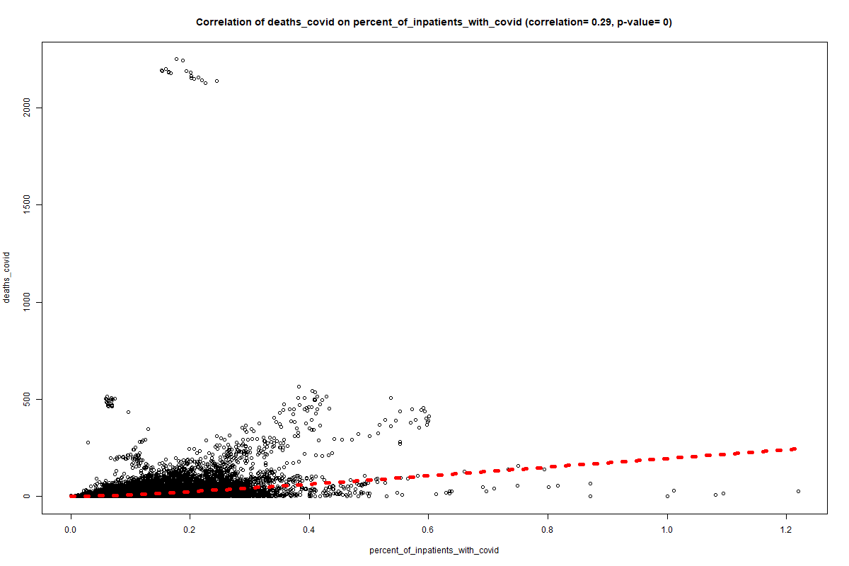
Positive and moderate correlation
1. The Pearson correlation is 0.29 but susceptible to outliers. The Kendall (0.47) and Spearman (0.63) correlations are better for outliers so consider it “moderate”.
2. The R2 you can calculate from the Pearson correlation is helpful in stating that the correlation is significant and the % of inpatients with covid explains 8% of the variance in covid deaths. It is an important predictor of deaths but there still are other important factors that remain.

Slide 11
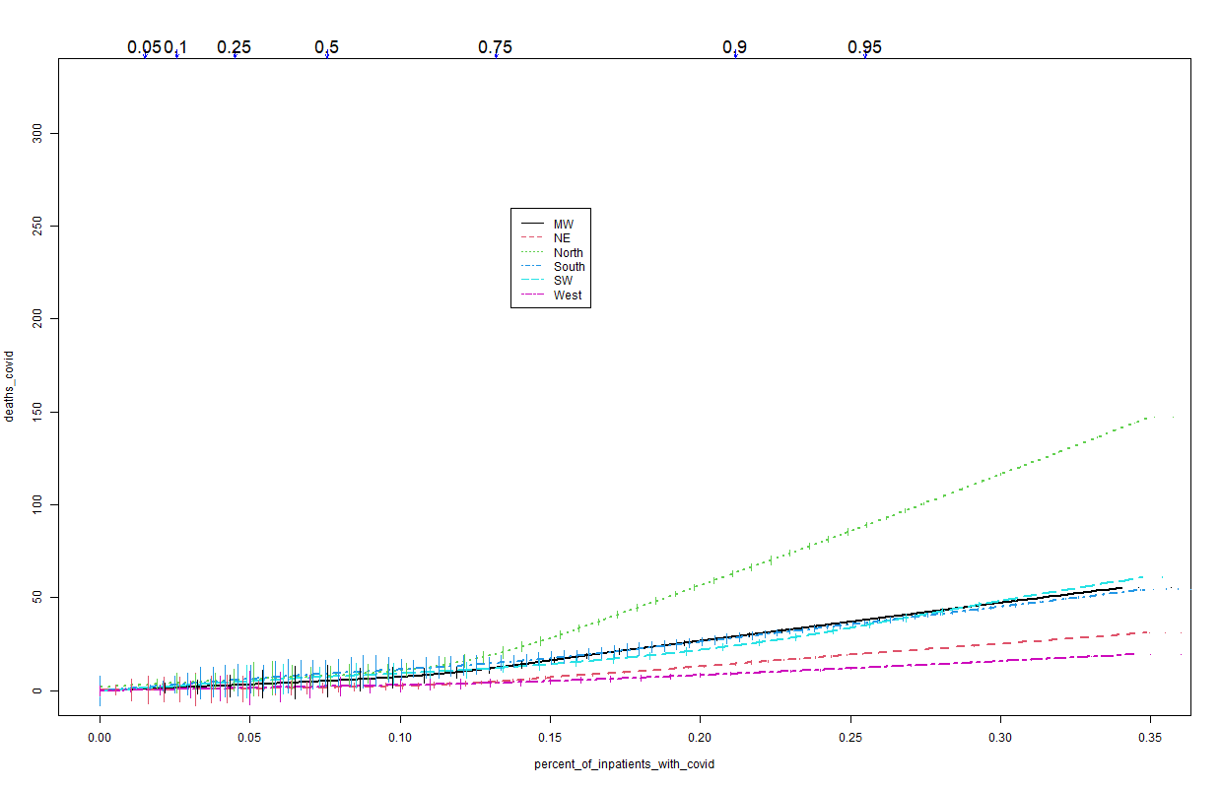
1. The number of deaths is most strongly associated with % of inpatients with covid in Eastern states. The North had the worst mortality as it spread there first.
2. The lower rates in the West may have been partially due to a better understanding in how to treat covid by time it reached the West in high numbers.
Region
Note: The more levels we use, the more data is required.
North
These Loess trend lines are descriptive only. They are similar to the scatterplots above but have multiple lines for each level in the “Region” factor. There are no datapoints nor correlation tests. Values at the top are percentiles of the X-axis variable.
West

Slide 12
Correlation matrix
A correlation can help identify which variables are closely related to the outcome and what variables may be redundant in your project.
Strongest correlation with covid deaths of retained variables.
Consider removing redundant variables that have correlations with each other above 0.80 or making composite variables. We’ll use PIWC instead of IBCU.

Slide 13
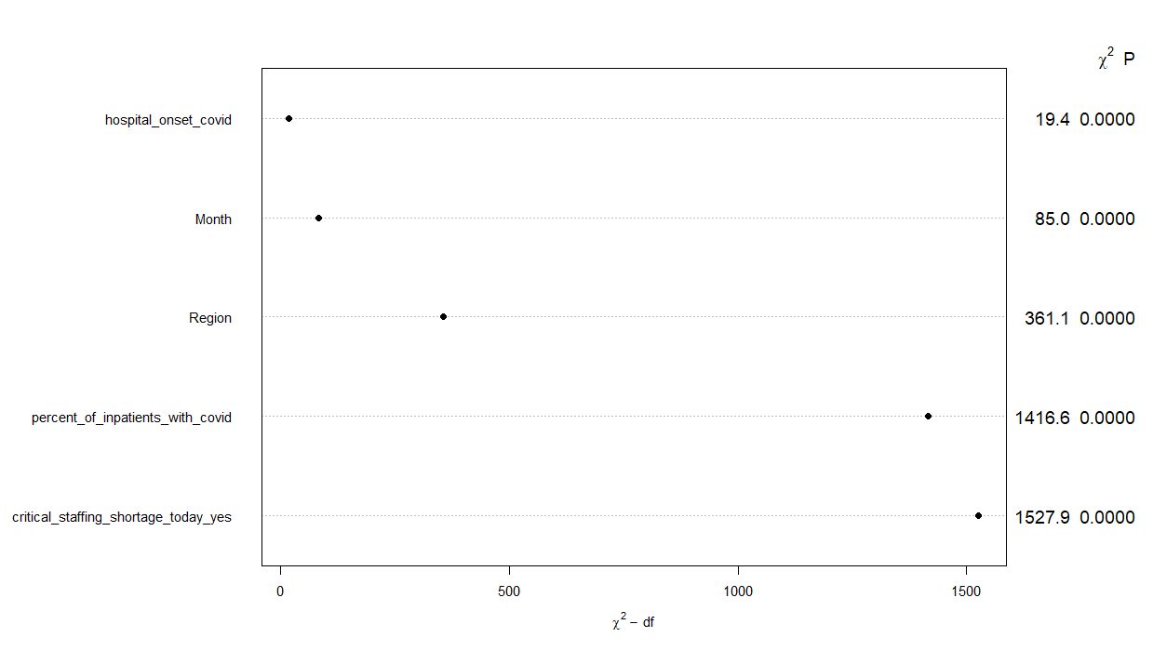
Variable importance results from a regression
The model R was bigger than the strongest variable in the correlation matrix.
Model results
R = 0.37
R^2= 0.14
Because of significant correlations between variables, the R^2 isn’t closer to the sum in the correlation matrix. However, we can identify important predictors from the matrix and identify which variables would have the most impact in understanding results

